Slide 3
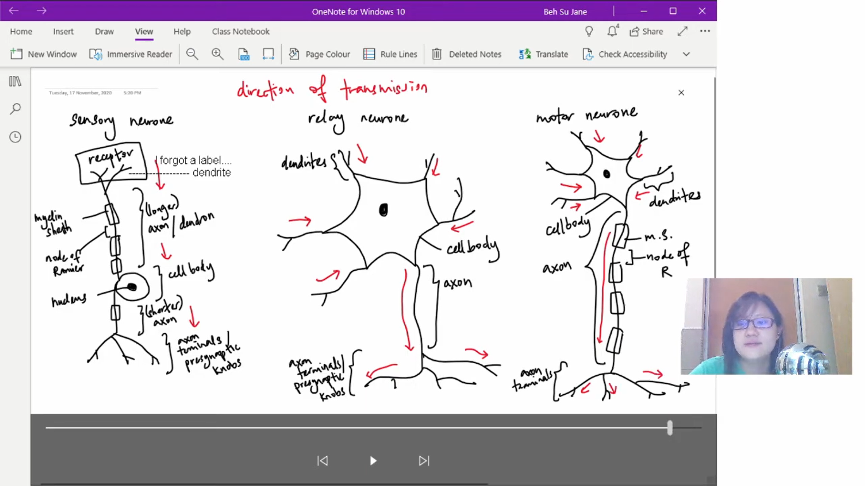

Slide 9
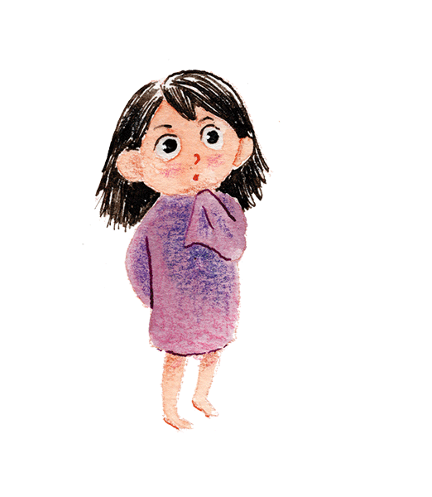

Slide 16
More ions leave and less ions inside so negative charged

Slide 24
Shorter refractory period= higher maximum frequency

Slide 26
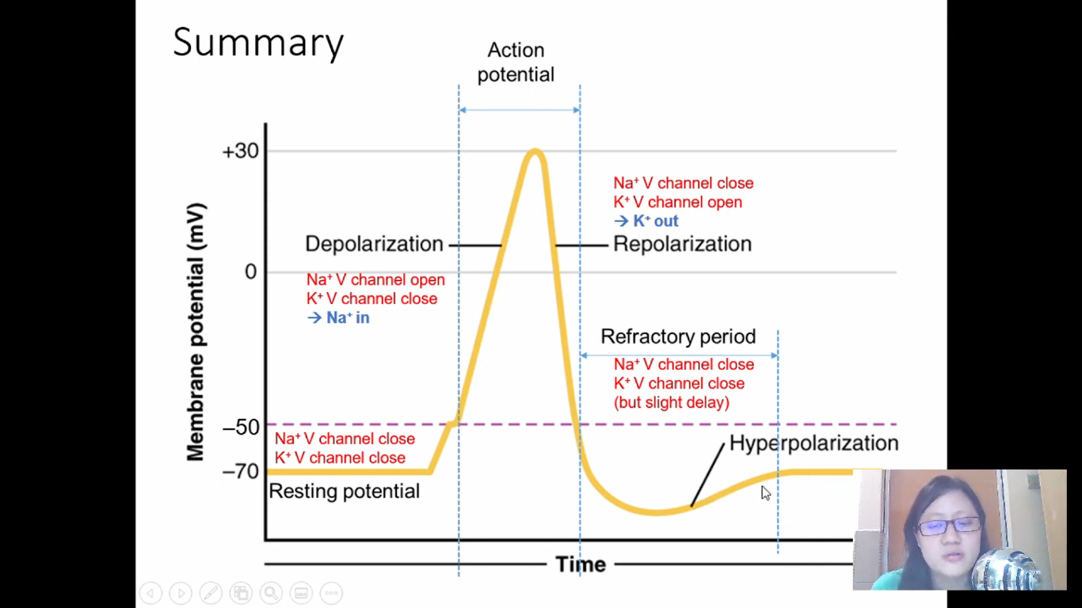

Slide 32
Nerve impulse transfers from one neuron to other neurons

Slide 37
Contract without nervous stimulation

Slide 39
Cord of strong, flexible tissue similar to rope

Slide 41
Network like

Slide 43
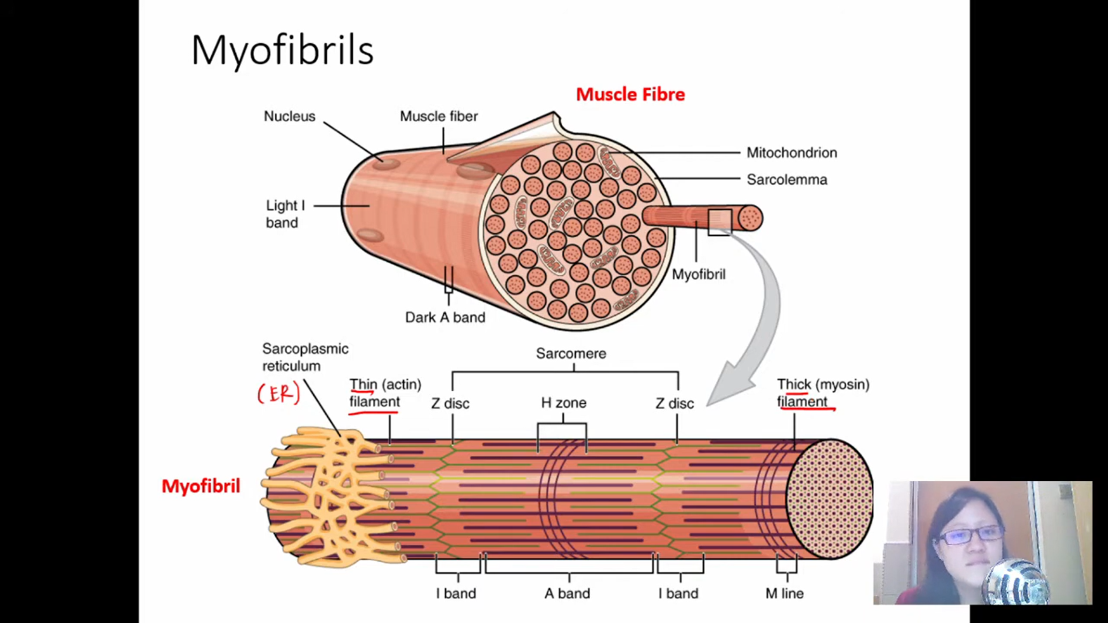

Slide 45
overlapping

Slide 46
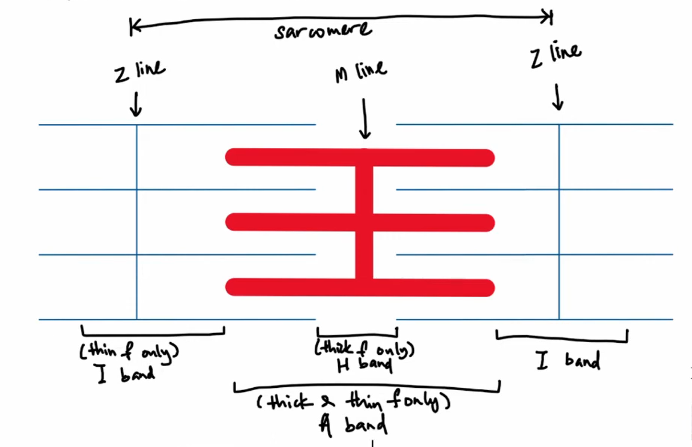

Slide 63
Hypertonic env

