Slide 3
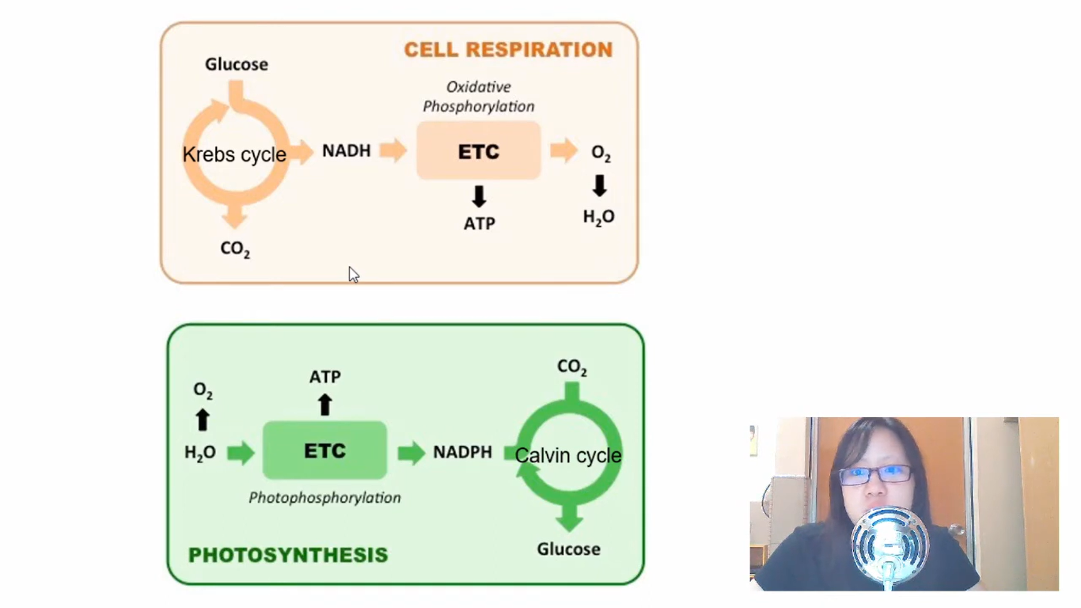

Slide 4
CO2

Slide 6
Green color
Orange and yellow colors

Slide 9
High ph rate at shorter wavelength, low ph rate at longer wavelength
No photosynthesis at this wavelength

Slide 10
Water evaporates and pigments are more concentrated

Slide 11
Also depends on pigments solubility in solvent

Slide 21
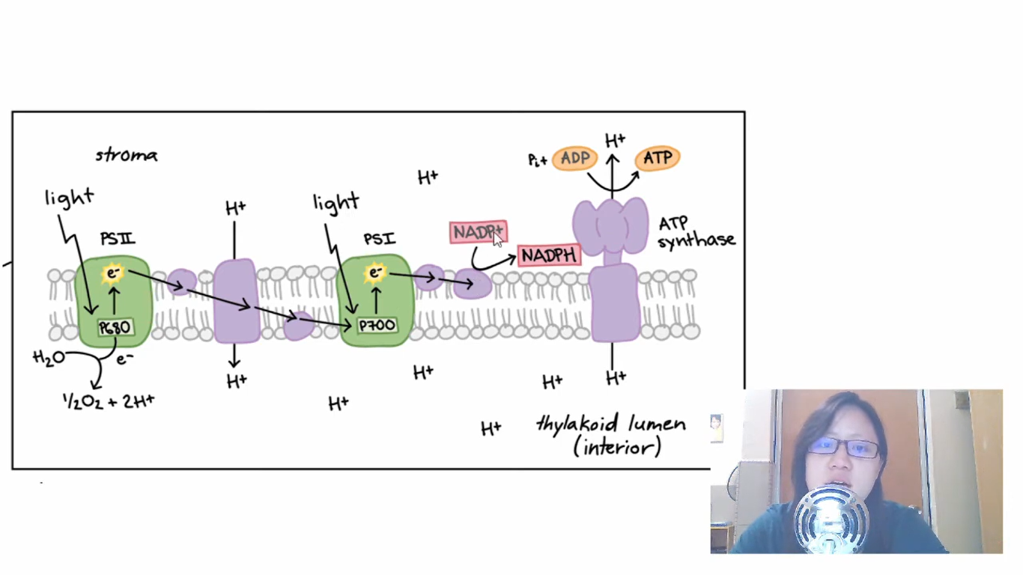

Slide 22
Reduced NADP

Slide 24
Reduced NADP

Slide 26
To measure rate of photosynthesis
From water in the presence of oxidizing agent
Reducing power

Slide 27
Photosynthesis and DCPIP changes from blue to colourless
No photosynthesis in dark

Slide 33
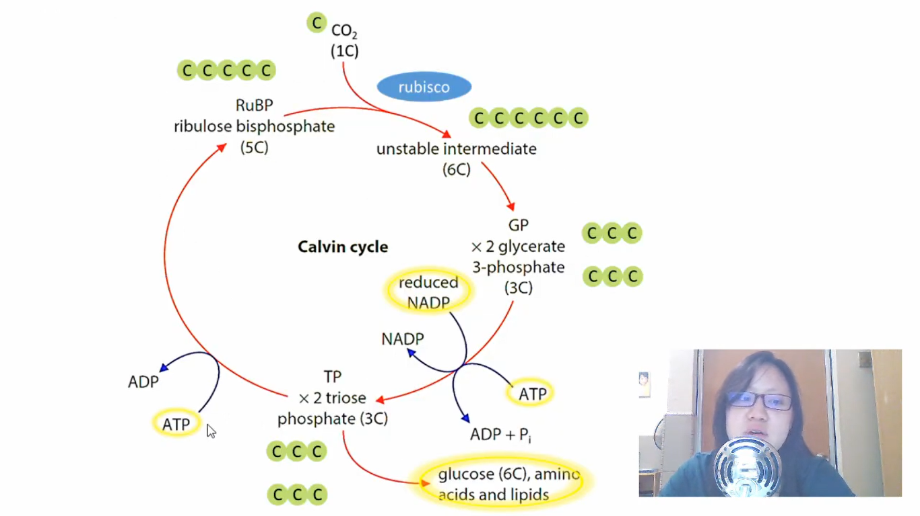
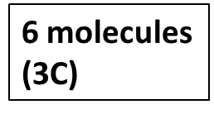
3 molecules
(3C)
3 molecules
(15C)
3 molecules
(18C)
6 molecules
(3C)
5 molecules
(3C)
1 molecule
(3C)

Slide 45
Capacity to adapt to env changes

