Slide 2
Introduction
My name is Miss Verda Masood
I am a Lecturer Biology/ Botany/Biotechnology
My intermediate in Pre-Medical is from PGC Civil lines Gujranwala with A+ grade, Bachelors in Botany is from GCU Lahore with 3.27cgpa, Masters in Botany from LCWU Lahore with 3.97cgpa and got 1st position and awarded with GOLD MEDAL & ROLL OF HONOUR & Cash prize of 10kRs and also awarded with PRIDE OF PERFORMANCE shield in my professional career
I have overall 5 years of work experience at Govt Islamia Clg Gujranwala, Aspire Clg Manawan Lahore, Unique group of institution Manawan Lahore, Times Clg Gujranwala, Lahore Grammer School, Beacon house School, Valeem (present) with IGCSE/O LEVELS/ A LEVELS/AS LEVELS
Most of my students scored 97% results (A*) in Biology & Botany.

Slide 4
Learning Objectives

Slide 5
Glow in the dark

Slide 7
release energy
Everyday, in 24 hrs , your body makes 40kg ATP but its consume by cells
Rapidness of synthesis and breaking down of ATP is called high turn over rate

Slide 11
Removal of inorganic phosphate gives 30.5kJ energy

Slide 17
use
Bcz a lot of energy is released

Slide 18
by adding phosphate group to glucose

Slide 19
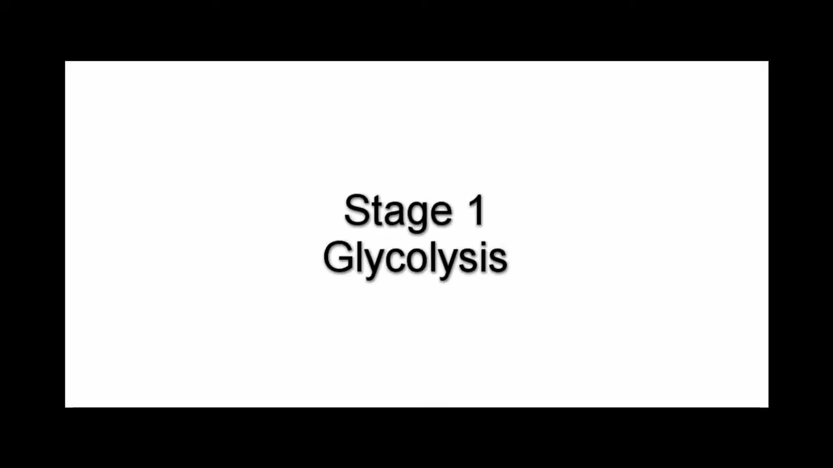

Slide 20
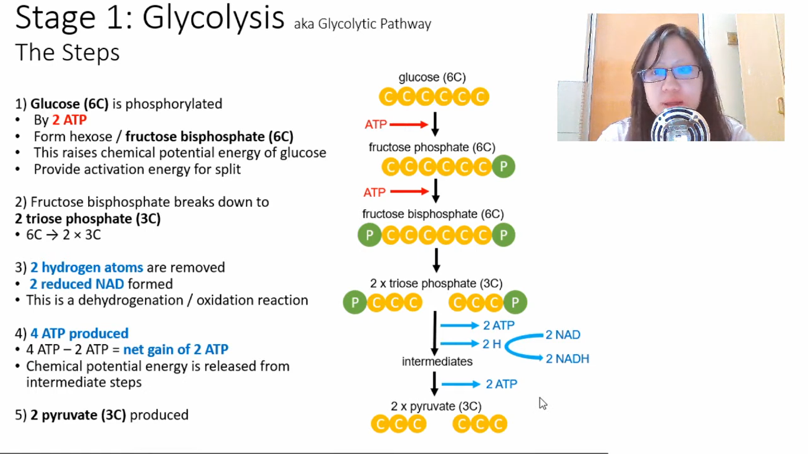
2 ATP are used

Slide 21
Direct formation of ATP by transferring a phosphate group from a high energy compound to a ADP molecule

Slide 25
Enzymes use it to catalyze reactions

Slide 32
H3

Slide 34
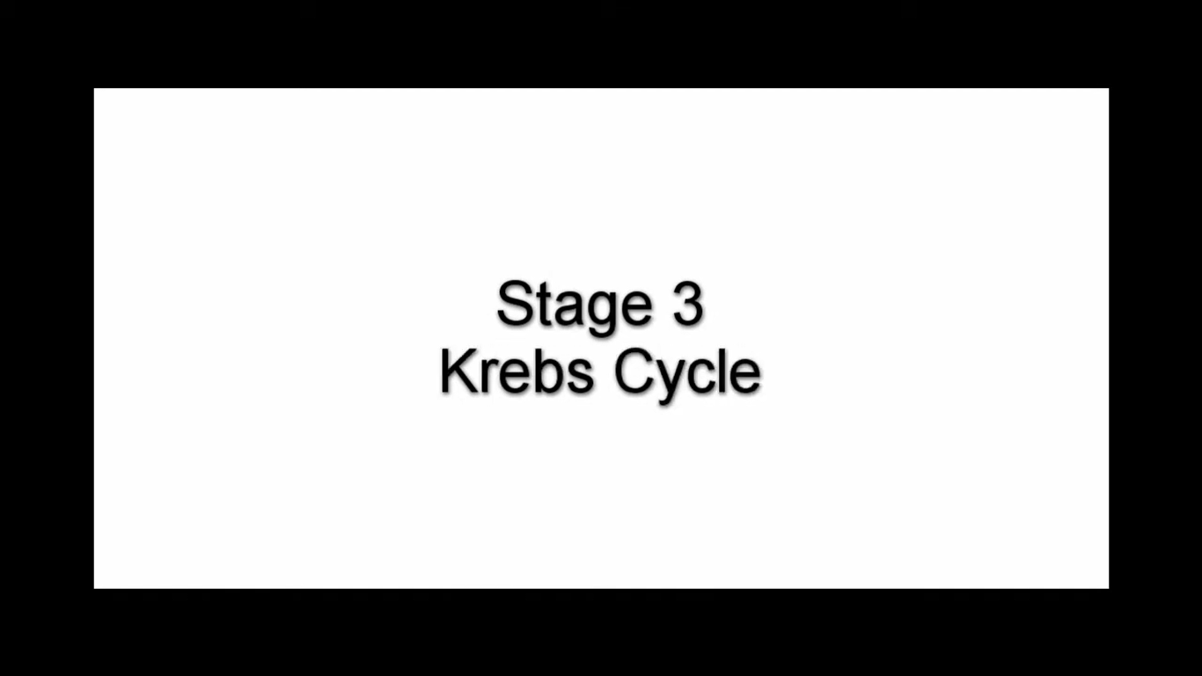

Slide 44
Active transport

Slide 47
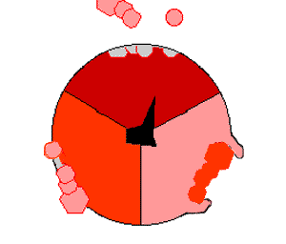
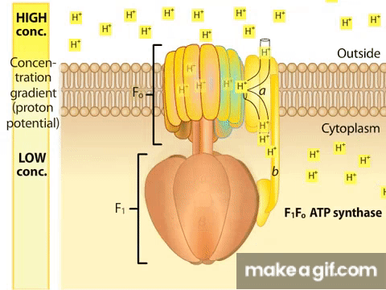
Span across membrane

