Slide 22
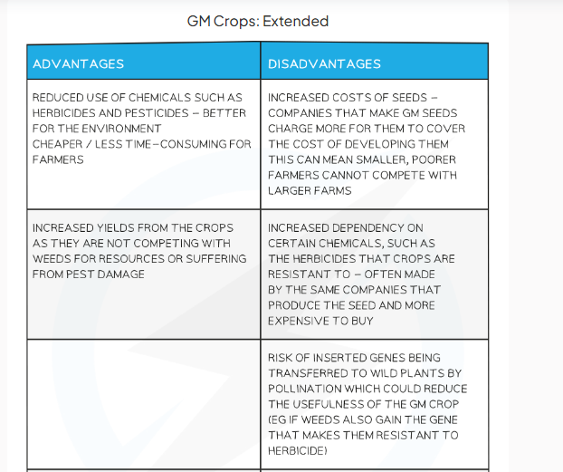

Slide 28
Everyday Products Made with Biotechnology

