Slide 1
Introduction to Accounting Ratios
By Sarah Azhar

Slide 2
The need for accounting ratios
Accounting ratios are used to enable us to analyse and interpret accounting statements.
Ratios deduce the data needed to make the incomplete records into a complete set of records, so that you can then draw up the ﬁnancial statements.
Without the use of such accounting ratios, the construction of ﬁnancial statements from incomplete records would often be impossible.

Slide 3
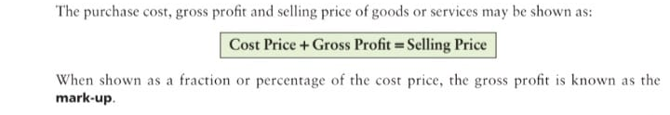
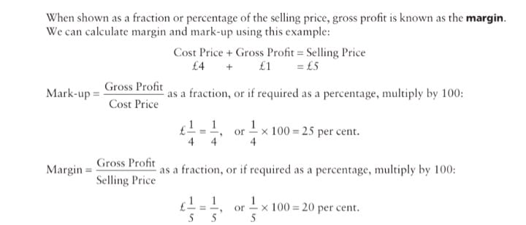
Mark-up and margin

Slide 4
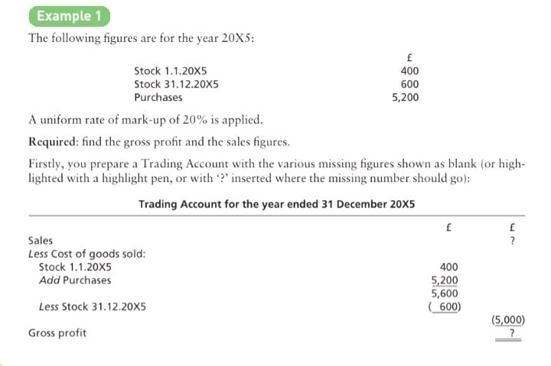
Calculating Missing figures

Slide 5
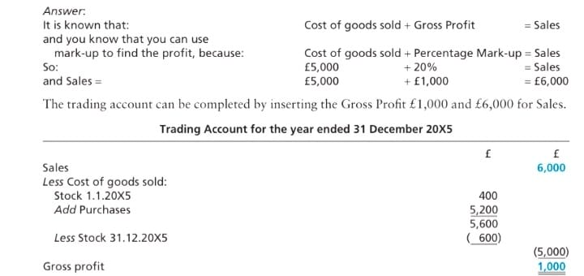
Calculating Missing figures

Slide 6
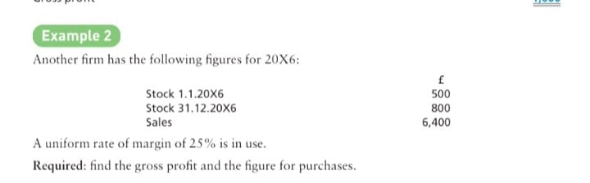
Calculating missing figures

Slide 7
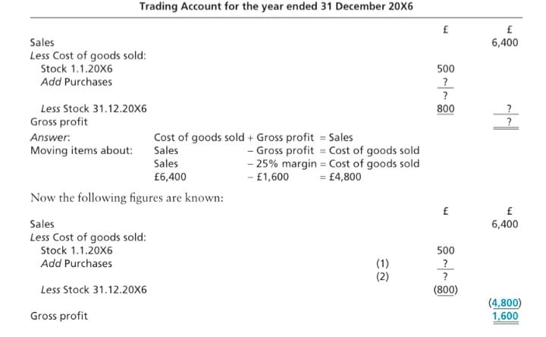
Calculating missing figures

Slide 8
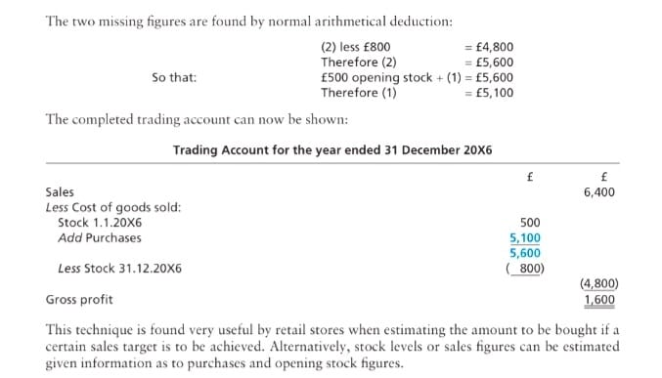
Calculating missing figures

Slide 9
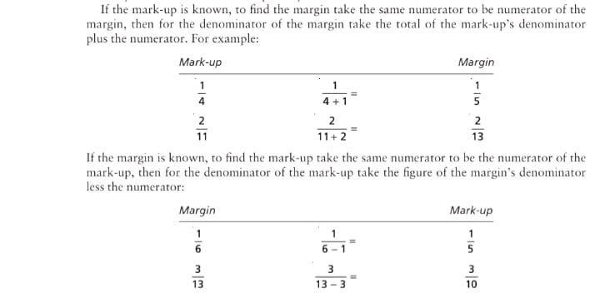
The relationship between mark-up and margin

Slide 10
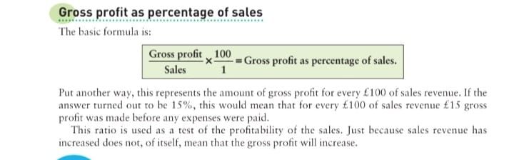

Slide 12
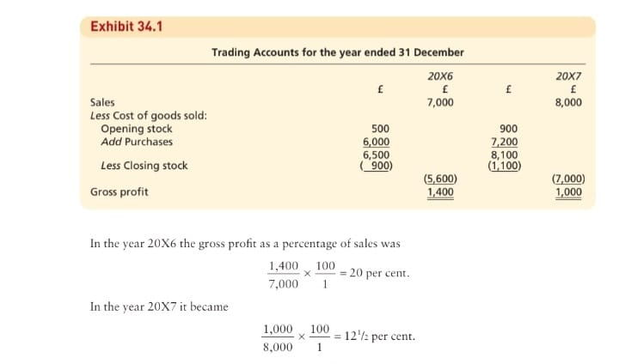

Slide 13
Gross profit margin
Sales had increased but, as the gross proﬁt percentage had fallen by a relatively greater amount, the gross proﬁt has fallen. There can be many reasons for such a fall in the gross proﬁt percentage, including:
1 Perhaps the goods being sold have cost more, but the selling price of the goods has not risen to the same extent.
2 There may have been a greater wastage or theft of goods. 3 There could be a difference in how much has been sold of each sort of goods, called the salesmix, between this year and last, with different kinds of goods carrying different rates of gross proﬁt per £100 of sales.
4 Perhaps in order to increase sales, reductions have been made in the selling price of goods.

Slide 14
The need for ratios
Without ratios, ﬁnancial statements would be largely uninformative to all but the very skilled. With ratios, ﬁnancial statements can be interpreted and usefully applied to satisfy the needs of the reader.
To bring the same basis of comparison to each company we need some form of common measure, like the gross margin, i.e. the amount of gross proﬁt on sales as a percentage.
Company A 23.58, Company B ,23.96 Company C, 25.94 Company D 23.84
Company C with a gross margin of 25.94% or, in other words, £25.94 gross proﬁt per £100 sales, has performed better than the other companies

Slide 15
How to use ratios
Figures are only comparable if they have been built up on a similar basis. The sales ﬁgures of Company X, which treats items as sales only when cash is received, cannot be properly compared with those of Company Z, which treats items as sales as soon as they are invoiced.

Slide 16
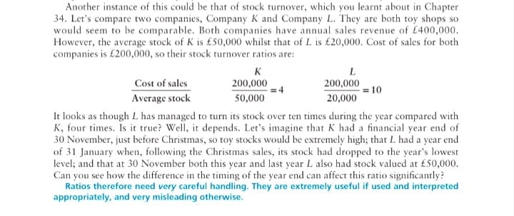
How to use ratios

Slide 17
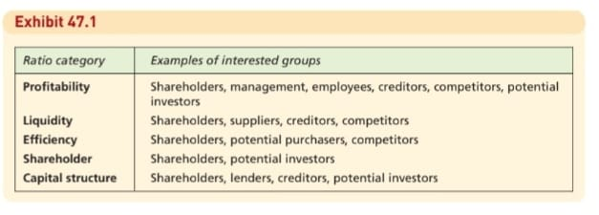
Users of ratios

Slide 18
Profitability ratios: Return On Capital Employed (ROCE)
This is one of the most important proﬁtability ratios, as it encompasses all the other ratios, and because an adequate return on capital employed is why people invest their money in a business in the ﬁrst place.
We will use the average of the capital account as the ﬁgure for capital employed, i.e. (opening balance + closing balance) ÷ 2.
In Businesses C and D in Exhibit 47.2, both businesses have made the same amount of net proﬁt, but the capitals employed are different.

Slide 19
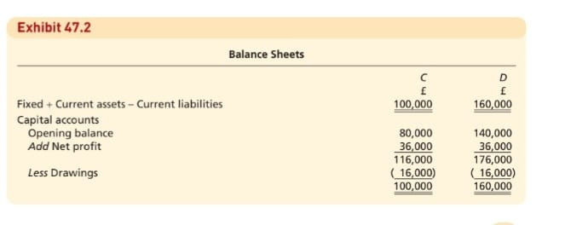
Profitability ratios: Return On Capital Employed (ROCE)

Slide 20
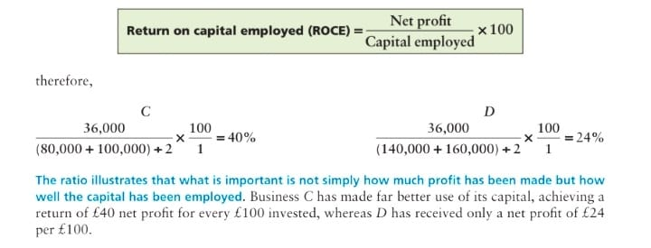
Profitability ratios: Return On Capital Employed (ROCE)

Slide 21

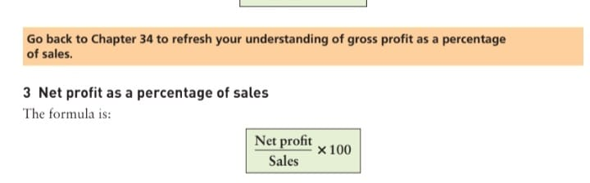
Profitability ratios

Slide 22
Liquidity ratios
It must be stressed that accounting is used, not just to calculate proﬁtability, but also to provide information that indicates whether or not the business will be able to pay its creditors, expenses, loans falling due, etc. at the correct times.
Failure to ensure that these payments are covered effectively could mean that the business would have to be closed down. Being able to pay one’s debts as they fall due is known as being ‘liquid’.
When it comes to the liquidity of a business, both its own ability to pay its debts when due and the ability of its debtors to pay the amount they owe to the business are of great importance.
Ratio analysis that focuses upon liquidity (or solvency) of the business generally starts with a look at two ratios (liquidity ratios) that are affected most by these two aspects of liquidity, the current ratio and the acid test ratio.

Slide 23
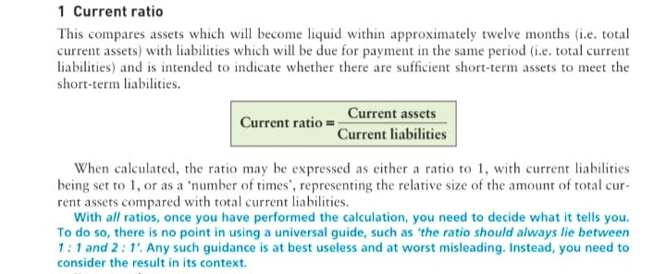
Liquidity ratios

Slide 24
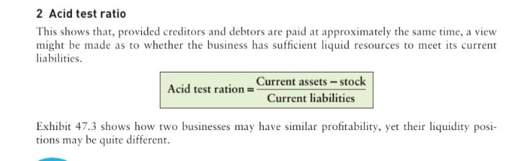
Liquidity ratios

Slide 25
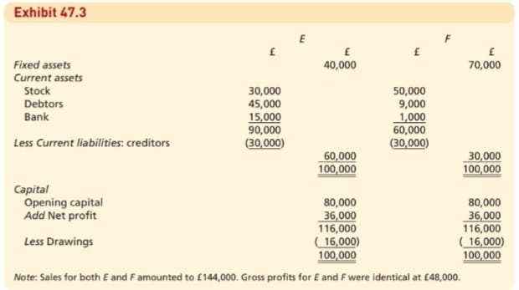

Slide 26
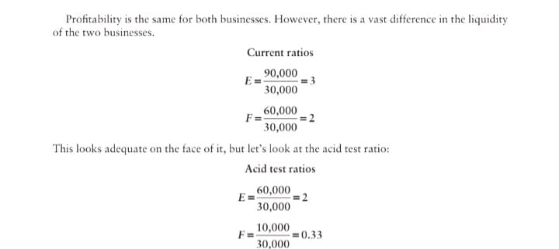
Liquidity ratios

Slide 27
Liquidity ratios
This reveals that F may be in trouble, as it will probably ﬁnd it difﬁcult to pay its current liabilities on time. No matter how proﬁtable a business is, unless it is adequately liquid it may fail.
However, although a business should be adequately liquid, it is possible for it to have too high a current ratio or acid test ratio. If too many resources are being held as current assets, it would make these two ratios appear healthy, but those resources could have been used more proﬁtably – you don’t get any interest on stock!
Too high a balance in a current account at the bank also means that resources are being wasted.

Slide 28
Stock turnover
Stock turnover measures how efﬁcient a business is at maintaining an appropriate level of stock.
When it is not being as efﬁcient as it used to be, or is being less efﬁcient than its competitors, this may indicate that control over stock levels is being undermined.
A reduction in stock turnover can mean that the business is slowing down. Stocks may be piling up and not being sold. This could lead to a liquidity crisis, as money may be being taken out of the bank simply to increase stocks which are not then sold quickly enough.

Slide 29
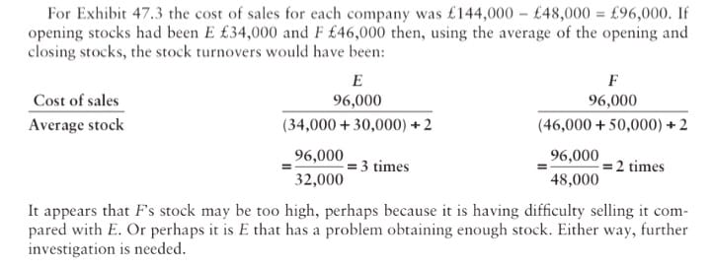
Stock turnover

Slide 30
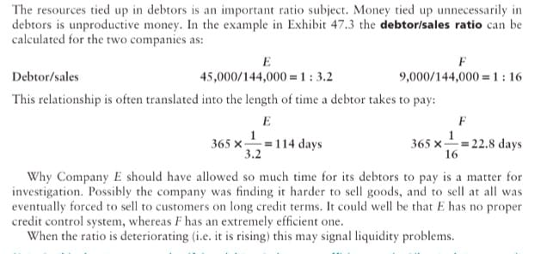
Debtor/sales ratio

Slide 31

Creditor/ purchases ratio
Assuming that purchases for E amounted to £92,000 and for F £100,000 then the creditor/purchases ratio can be calculated for each as:

Slide 32
Benefits or Advantages of Inter Firm or Intra Firm comparison
The management can pay special attention on the weakness area of business to take suitable action.
2. Uniform information is available to all participating companies of inter firm comparison.
3. An analyst has expert knowledge and experience in interpreting the results of inter firm comparison. Hence, every company gets very valuable information.
4. The results are obtained only on the basis of accurate data collected by the analyst.

Slide 33
Disadvantages or Limitation of Inter Firm or Intra Firm comparison
The success of inter-firm comparison or intra firm comparison is fully based on the co-operation of participation companies or departments. The degree of co-operation is responsible for degree of success.
2. Some accounting data are confidential in nature. Such data are not available to the analyst for proper inter-firm comparison. If so, no benefit is available through inter firm comparison.
3. Misuse of ratios may lead to misleading results.
4. Fruitful results cannot be obtained if the companies are not of the same size and character.

Slide 34
Disadvantages or Limitation of Inter Firm or Intra Firm comparison
There is no use of inter firm comparison when different forms of business organization are compared.
6. Accounting procedures and policies followed by participating companies may not be uniform and as such accounting ratios used for comparison may not give proper results.
7. Every ratio has its own limitations. These are applicable to inter firm comparison also.

