Slide 1
IGCSE/O-Level ACCOUNTING
By: Sir Haseeb

Slide 2
Syllabus
Basic theory, Accounting equation
Double entry, ledgers, books
Trial balance, errors, suspense a/c, control account, bank reconciliation
Revenue expenditure, capital expenditure, depreciation, doubtful debts, prepaid and accrued expense/income, inventory valuation
Financial statements of sole trader, partnership, limited company, club/npo, manufacturing, single entry/incomplete record
Ratio accounting+ analyses
Accounting principle and concepts

Slide 3
Paper pattern
P1-MCQ’s 35 mark (75 min)
P2-numerical+ theoretical questions, 5 questions of 20 marks each (105 mins)

Slide 4
What is Accounting, Accountants and bookkeeping
Accounting
process of identifying, measuring, and communicating economic information to permit informed judgements and decisions by users of that information.
Accountants
interpret the information they produce, all in order to assist in decision-making
Book Keeping
Bookkeeping is the process of recording data relating to accounting transactions in the accounting books.

Slide 5
Purpose of Financial Accounting
if they are making a profit or a loss;
what the entity is worth;
what a transaction was worth to them;
how much cash they have;
how wealthy they are;
how much they are owed;
how much they owe;
enough information so that they can keep a financial check on the things they do.

Slide 6
Users of Financial Information (Stakeholders)
• Managers: These are the day-to-day decision-makers. They need to know how well things are progressing financially and about the financial status of the business.
• Owner(s) of the business: They want to be able to see whether or not the business is profitable. In addition they want to know what the financial resources of the business are.
A prospective buyer: When the owner wants to sell a business the buyer will want to see such information
The bank: If the owner wants to borrow money for use in the business, then the bank will need such information.
Tax inspectors: They need it to be able to calculate the taxes payable.
A prospective partner: If the owner wants to share ownership with someone else, then the would-be partner will want such information.
Investors, either existing ones or potential ones: They want to know whether or not to invest their money in the business.
Creditors: They want to know if there is any risk of not being paid what they are due.

Slide 7
Accounting Equation
Assets= Liabilities + Capital
or
Net Assets(Assets-liabilities)= Capital
In double entry
DR (left hand side)=CR (right hand side)
The amount of the resources supplied by the owner is called capital.
The actual resources that are then in the business are called assets.
Liabilities is the name given to the amounts owing to these people for these assets.

Slide 8
Classification of items
Non-current assets (fixed assets) are assets which have a long life bought with the intention to use them in the business and not with the intention to simply resell them, e.g. buildings, machinery, fixtures & fittings (e.g. shelves), motor vehicles, property.
Current assets are assets consisting of cash, bank, Account receivable, and goods for resale (Inventory) or items having a short life (i.e. no more than a year remaining on the date of the statement of financial position) . For example, the amount (and so the value) of inventory goes up and down as it is bought and sold. Similarly, the amount of money owing to a business by debtors will change quickly, as the business sells more to them on time and when they pay their debts. The amount of money in the bank will also change when it is received or paid out.
Current liabilities are those liabilities which have to be paid within no more than a year from the date on the statement of financial position, e.g. accounts payable for goods purchased, bank overdraft.
Non Current Liabilities are those liabilities that have to be paid after one year from the date on the statement of financial position i.e. long term loan, debentures, preference shares
Capital: Investment brought into the business by the owners/investors i.e owner investment, ordinary shares, retained/net profit note (Drawings are subtracted from capital)

Slide 9
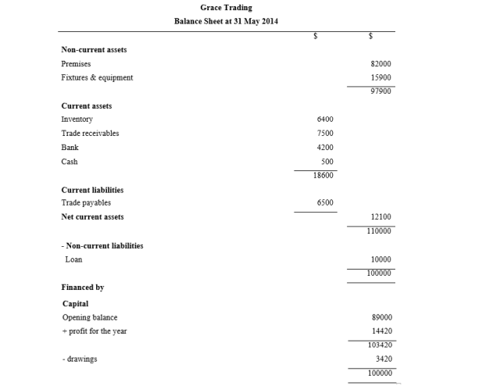
Balance Sheet/ Statement of Financial Statement Format (Vertical)

Slide 10
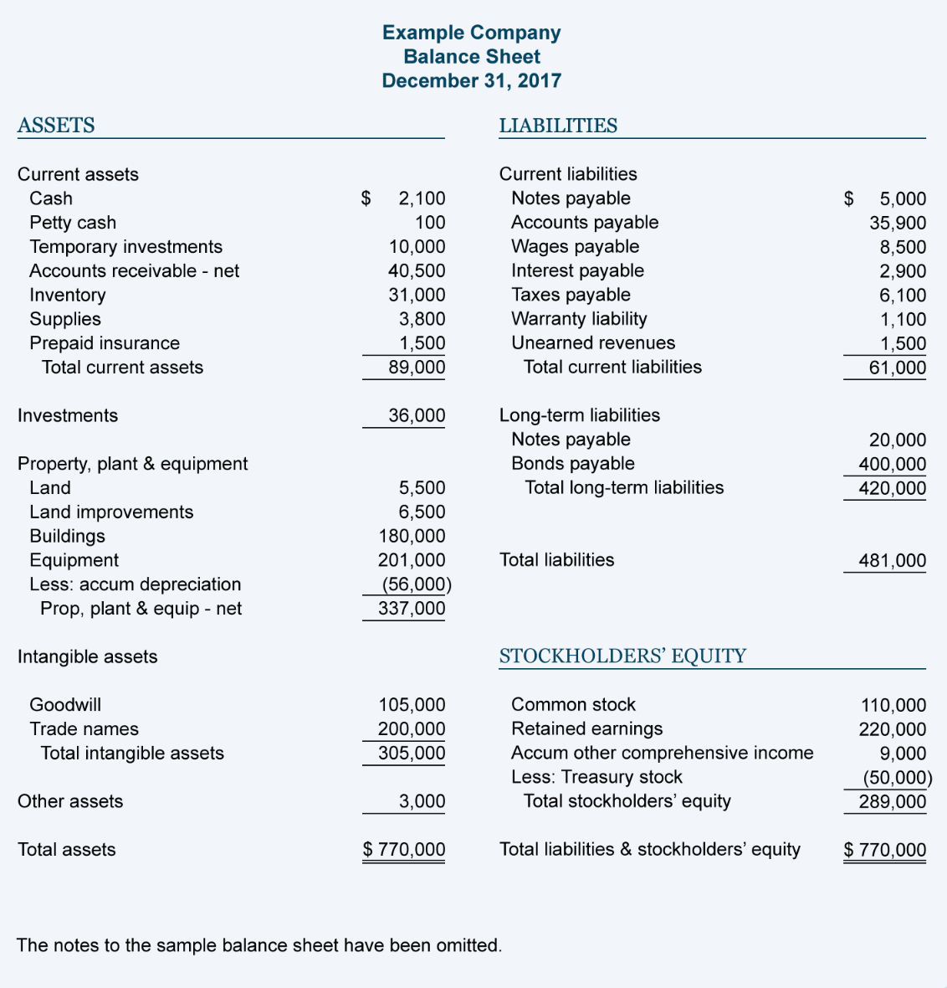
Balance Sheet Horizontal Format

Slide 11
Income Statement Format/Profit and loss account

Slide 12
Nature of Account
Item | Dr/Cr | Increase | Decrease | Close Off | Starting Balance
Assets | Dr | Dr | Cr | Balance c/d | Balance b/d
Capital | Cr | Cr | Dr | Balance c/d | Balance b/d
Liabilities | Cr | Cr | Dr | Balance c/d | Balance b/d
Provision | Cr | Cr | Dr | Income Statement | Discussed later
Accumulated Depreciation | Dr | Dr | Cr | Balance c/d | Discussed later
Income/Sales | Cr | Cr | Dr | Profit and loss A/c | -
Expense | Dr | Dr | Cr | Profit and loss A/c | -
Cost of Sales | Dr | Dr | Cr | Profit and Loss A/c( Except inventory) | -

Slide 13
Key note
DEBIT ALWAYS EQUAL CREDIT
NET ASSETS ALWAYS EQUAL CAPITAL

Slide 14
T Accounts
Excel sheet
Key note: Assets, liabilities and capital are closed by balance c/d
Every balance c/d occurs on the final day of financial statement e.g 31 dec 2021
Every Balance c/d must have an equal balance b/d on the first day of next financial year 1st jan 2022
Every income statement item except inventory is closed by profit and loss account unless examiner asks for cost of sales account and trading profit account
Dates are integral and contain marks
If examiner asks for return inward and return outward account, the you have to make separate account and cannot include in net purchases/ net sales account.

Slide 15
Drawings
Cash drawing= cash taken out from business for personal use
Drawing dr
cash cr
Drawing of goods= goods taken out of business for personal use
Drawing dr
Purchases cr
Drawings are always closed out by capital account

Slide 16
Trial Balance
A type of trial balance could be drawn up by listing all the accounts and then entering the total of all the debit entries in each account in one column and the total of all the credit entries in each account into another column
We need to check that for each debit entry there is also an equal credit entry. In order to check that there is a matching credit entry for every debit entry, we prepare something called a trial balance.
Trial balance is always made from closing balances such as balance c/d or profit and loss account
Incase of inventory always take opening inventory in trial balance

Slide 17
Format pg 103 adobe pg 78 OF BOOK

